Slide 1
04 | Connecting to databases from Python
Susan Ibach | Technical Evangelist
Christopher Harrison | Content Developer

Slide 2
Module Overview
How do I connect to a database from Python?
Inserting a record
Retrieving a record

Slide 3
How do I connect to a database from Python?

Slide 4
Code that works with databases follows a pattern
Install a library that supports connections to your database
Import library into your code
Create a connection to the database
Execute the SQL Command
Save your changes (if you are modifying data)
Close the connection

Slide 5
1. Install a library that supports your database
pypyodbc is a library that was written to help Python connect to databases that support an ODBC connection
ODBC is a connection type supported by most databases including SQL Server and SQL Azure

Slide 6
1. Install a library that supports your database
pymssql is a library that was written to help Python connect to SQL Server
Version 2.1 of pymssql also supports Azure

Slide 7
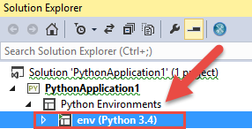
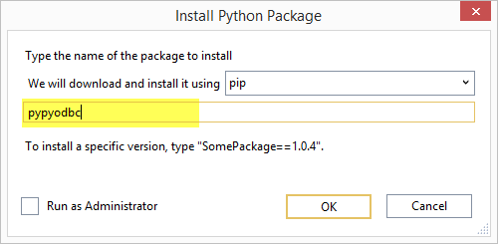

1. Install the pypyodbc library
If you don't already have one, create a virtual environment for Python 3.4 in your Python project
Install the python package pypyodbc in your virtual environment
Import the pypyodbc library in your code

Slide 8
2. Create a connection to the database
You will need
Server name (localhost if it's the PC where code is running)
Database name
Login information (user id & password)

Slide 9
When you install SQL Server you need to ensure it will allow a user name and password for logon
SQL Server operates in two modes
Windows Authentication (uses your Windows account to log in)
Mixed/SQL Authentication (provide a username and password to log in)
For a Python website, you want to use Mixed/SQL Authentication. Find out how to ensure the correct mode and set up a system administrator login account here

Slide 10
Use the connect method to get a connection
pypyodbc.connect('DRIVER={DriverName};'
'SERVER=ServerName;'
'DATABASE=DatabaseName;'
'UID=userName;PWD=password')
Example
myConnection = pypyodbc.connect('DRIVER={SQL Server};' 'SERVER=localhost;' 'DATABASE=QuizDb;' 'UID=sa;PWD=P@ssw0rd')

Slide 11
WARNING! Code that executes commands on a data source often raise errors

Slide 12
Add error handling to your code
print('Trying to connect')
try :
myConnection = pypyodbc.connect('DRIVER={SQL Server};'
'SERVER=localhost;'
'DATABASE=QuizDb;'
'UID=sa;PWD=P@ssw0rd')
print ('Connected')
except :
print ('Could not connect')
TIP: When you are testing your code for the first time, it can be helpful to add print statements to see if your code is working

Slide 13
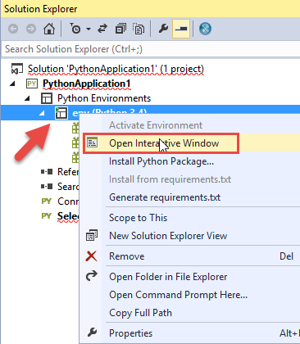
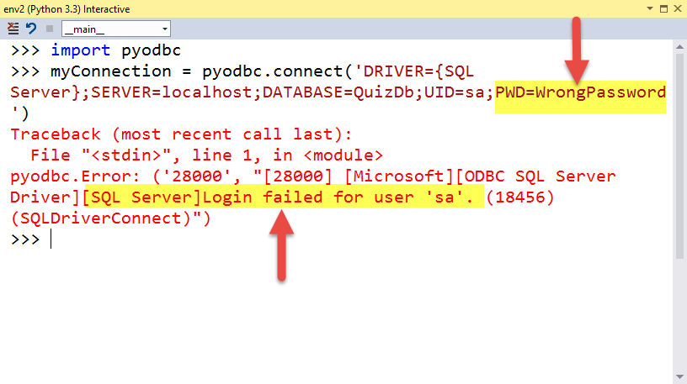
Visual Studio tip!
If you are getting errors when your database code executes use the interactive window to get detailed error messages
Right click on your environment and choose Open Interactive Window
Type your code into the interactive window and check error messages

Slide 14
Connect to SQL Server

Slide 15
How do I add a row to a table?

Slide 16

What have we done so far?
Install a library that supports connections to your database
Import library into your code
Create a connection to the database
Run the SQL Command
Save your changes (if you are modifying data)
Close the connection

Slide 17
In SQL we use the INSERT statement to add rows
Questions
QuestionName | Description | CorrectAnswer | CategoryId
HockeyFact | How long is one period of hockey? | 20 minutes | 1
FranceCapital | What is the capital of France? | Paris | 2
CanadaCapital | What is the capital of Canada? | Ottawa | 2
INSERT INTO tableName
(col1, col2,col3,…)
VALUES (val1, val2, val3, …)
INSERT INTO Questions
(QuestionName, Description, CorrectAnswer, CategoryId)
VALUES ('HockeyFact', 'How long is one period of hockey','20 minutes',1)

Slide 18
4. In Python you run a SQL command using the execute method
myCursor = myConnection.cursor()
SQLInsertCommand = ("INSERT INTO Questions "
"(QuestionName, Description, CorrectAnswer, CategoryId) "
"VALUES (?,?,?,?)")
Values = ['HockeyTrivia','How long is a hockey period?','20 minutes',1]
myCursor.execute(SQLInsertCommand,Values)

Slide 19
Do your cleanup
5. Save your changes (if you are modifying data) 6. Close your connection
myConnection.commit()
myConnection.close()

Slide 20
Put it all together with error handling and you have something like this
import pypyodbc
try:
myConnection = pypyodbc.connect('Driver={SQL Server};'
'Server=localhost;'
'Database=testdb;'
'uid=sa;pwd=P@ssw0rd')
try:
myCursor = myConnection.cursor()
SQLInsertCommand = ("INSERT INTO Questions "
"(QuestionName, Description, CorrectAnswer, CategoryId) "
"VALUES (?,?,?,?)")
Values = ['HockeyTrivia','How long is a hockey period?','20 minutes',1]
myCursor.execute(SQLInsertCommand,Values)
myConnection.commit()
except:
print("could not insert")
myConnection.close()
except:
print("Could not connect")

Slide 21
Insert a row from the database

Slide 22
Retrieving a row from the database

Slide 23
In SQL we use the SELECT statement to retrieve a row from a table
QuestionName | Description | CorrectAnswer | CategoryId
HockeyFact | How long is one period of hockey? | 20 minutes | 1
FranceCapital | What is the capital of France? | Paris | 2
CanadaCapital | What is the capital of Canada? | Ottawa | 2
SELECT col1,col2, col3, …
FROM tablename
WHERE columname= searchString
SELECT Description, CorrectAnswer
FROM Questions
WHERE QuestionName = 'HockeyFact'
How long is one period of hockey?
20 minutes
description correctanswer
------------------------------------------------------------------------

Slide 24
We execute the SQL Command in Python the same way we executed the INSERT Command
myCursor = myConnection.cursor()
SQLSelectCommand = ("SELECT description, correctAnswer "
"FROM questions "
"WHERE questionName = ?")
Values = ['HockeyTrivia']
myCursor.execute(SQLSelectCommand,Values)
TIP: Because we aren't changing any data, we don't need to save/commit our changes

Slide 25
But how do we access returned values in our code?
Use the fetchone() method of the cursor
fetchone returns an array that contains each column returned
Row 0 of the array contains the first column, row 1 the second column, and so on
SELECT Description, CorrectAnswer
FROM Questions
WHERE QuestionName = 'HockeyFact'
QuestionName | Description | CorrectAnswer | CategoryId
HockeyFact | How long is one period of hockey? | 20 minutes | 1
FranceCapital | What is the capital of France? | Paris | 2
CanadaCapital | What is the capital of Canada? | Ottawa | 2
How long is one period of hockey?
20 minutes
results
index | Content
0
1

Slide 26
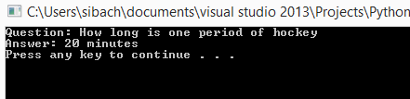
In your code that looks something like this
myCursor.execute(SQLSelectCommand,Values)
results = myCursor.fetchone()
print ("Question: " + results[0])
print ("Answer: " + results[1])

Slide 27
Put it all together with error handling
import pypyodbc
try:
myConnection = pypyodbc.connect('Driver={SQL Server};'
'Server=localhost;'
'Database=testdb;'
'uid=sa;pwd=P@ssw0rd')
try:
myCursor = myConnection.cursor()
SQLSelectCommand = ("SELECT description, correctAnswer "
"FROM questions "
"WHERE questionName = ?")
Values = ['HockeyTrivia']
myCursor.execute(SQLSelectCommand,Values)
results = myCursor.fetchone()
print ("Question: " + results[0])
print ("Answer: " + results[1])
except:
print("could not retrieve record")
myConnection.close()
except: print("Could not connect")

Slide 28
Select a row from our table

Slide 29
But what if I am using Microsoft SQL Azure?

Slide 30
All you need to change is the connection string!
myConnection = pypyodbc.connect('Driver={SQL Server};'
'Server=tcp:yourservername.database.windows.net,1433;'
'Database=databasename;'
'Uid=username@servername;Pwd=password;'
'Encrypt=yes')
Example
myConnection = pypyodbc.connect('Driver={SQL Server};'
'Server=tcp:1234fgt7.database.windows.net,1433;'
'Database=MyAzureDatabase;'
'Uid=susan@ox93zvw;Pwd=P@ssw0rd;'
'Encrypt=yes')

Slide 31
How does this fit into our website?

Slide 32
Update website to read from our SQL Database

Slide 33
What did we learn?
How to connect to a database using Python
How to insert a row in a table using Python
How to select data from a table using Python

